Slide 1
What does it take to LAND on Mars?
Whitney Eggers Emmett, Idaho
Aaron McKinnon, Boise, Idaho
Mentors: Behzad Raiszadeh, Eric Queen
Click here for review videos of Basic Rocket Information

Slide 2
Challenge#2 Entry guidance
Challenge#3 slowing down enough to land
Challenge #1
Entering the atmosphere
What does it take to LAND on Mars?
Mouse over to see how the NASA engineers over came these challenges!
Challenge#4
Preparing to Land
Challenge #5
Landing
Done with the Challenges? Click here for a mission “parts” tour video and a sweet simulation of the flight and landing

Slide 3
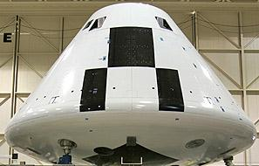
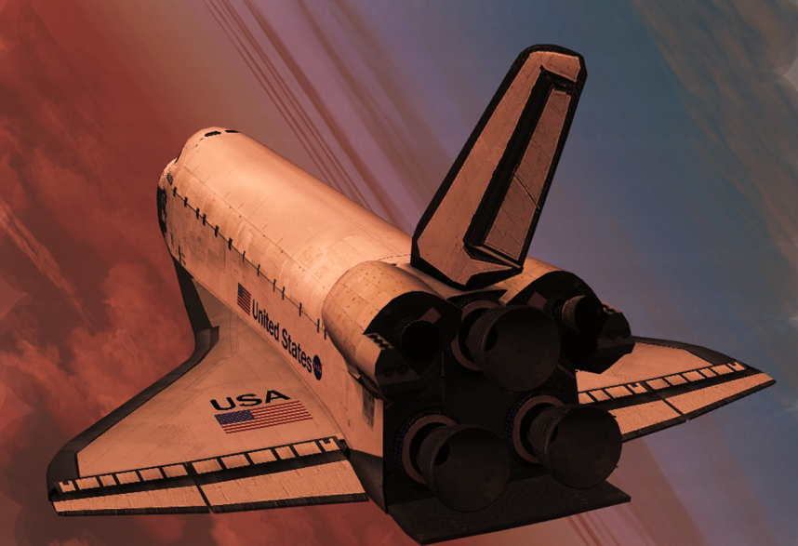
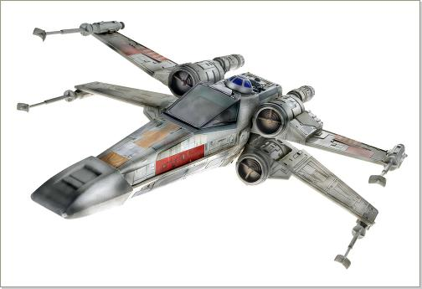
Challenge #1: Coming in too fast could burn up the spacecraft! Which craft would you choose to survive the heat?
A B C

Slide 4
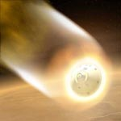
Correct!!!
This shape reduces heating as the capsule enters the atmosphere.
In fact, 99% of the heat energy created during entry is absorbed by the heat shield at the bottom of the capsule. It will be traveling at 13,000 miles per hour (5,800 meters per second!) the speed of sound during entry!
Back to Challenge #1 Home Go to Challenge #2

Slide 5
Science fiction is fun, but in reality this vehicle COULD NOT land on Mars because it does not have sufficient protection from heating!!!
Back to Challenge #1 Home Go to Challenge #2

Slide 6
The shuttle is too big and heavy. It will not fit inside the launch vehicle (a.k.a the rocket).
The shuttle is too big and heavy. It will not fit inside the launch vehicle (a.k.a the rocket).
Back to Challenge #1 Home Go to Challenge #2

Slide 7
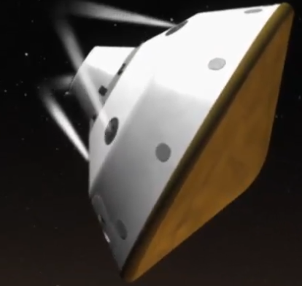
Challenge #2: Which idea will work for an entry guidance plan through the atmosphere of Mars?
Booster rockets
Cruise through the atmosphere like a rock
Use small booster rockets to allow some control of the descent

Slide 8
Correct! This idea has worked in the past and will still work…all the previous vehicles that have landed on Mars have flown in a straight, uncontrolled path to the surface.
Back to Challenge #2 Home Go to Challenge #3

Slide 9
Correct!!!
The Mars Science Laboratory will be the first time that a vehicle will be able to control its path to the surface of Mars.
Back to Challenge #2 Home Go to Challenge #3

Slide 10
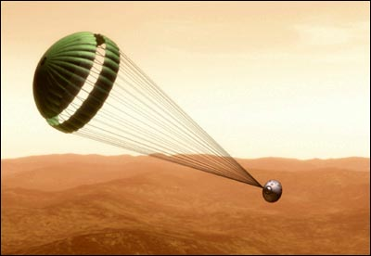
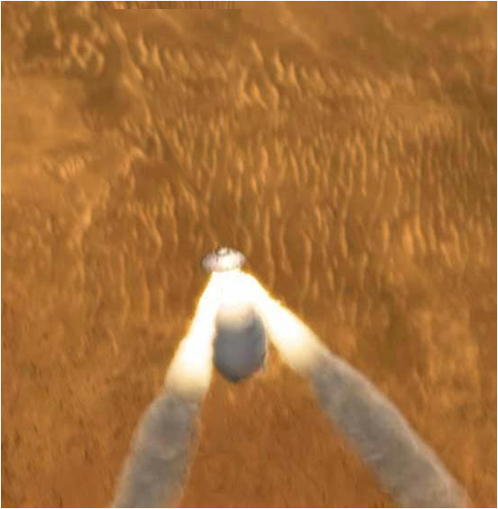
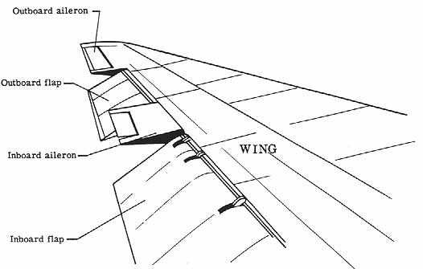
Challenge #3: Final descent: ….The capsule has slowed from 17 times the speed of sound (Mach 17 ) down to mach 2. How does the capsule slow down enough to release the rover?
A B C

Slide 11
Flaps, like on an airplane wing, are not big enough to slow down enough in the thin Martian atmosphere.
Back to Challenge #3 Home Go to Challenge #4

Slide 12
Correct!!!
Even though the Martian atmosphere is not as thick as Earths’, this parachute works well , allowing the craft to slow down enough
Back to Challenge #3 Home Go to Challenge #4

Slide 13
Firing rockets towards the surface, opposite of the high speed motion, will not provide enough deceleration and the amount of fuel is too heavy and expensive. NASA is working on this!!
Back to Challenge #3 Home Go to Challenge #4

Slide 14
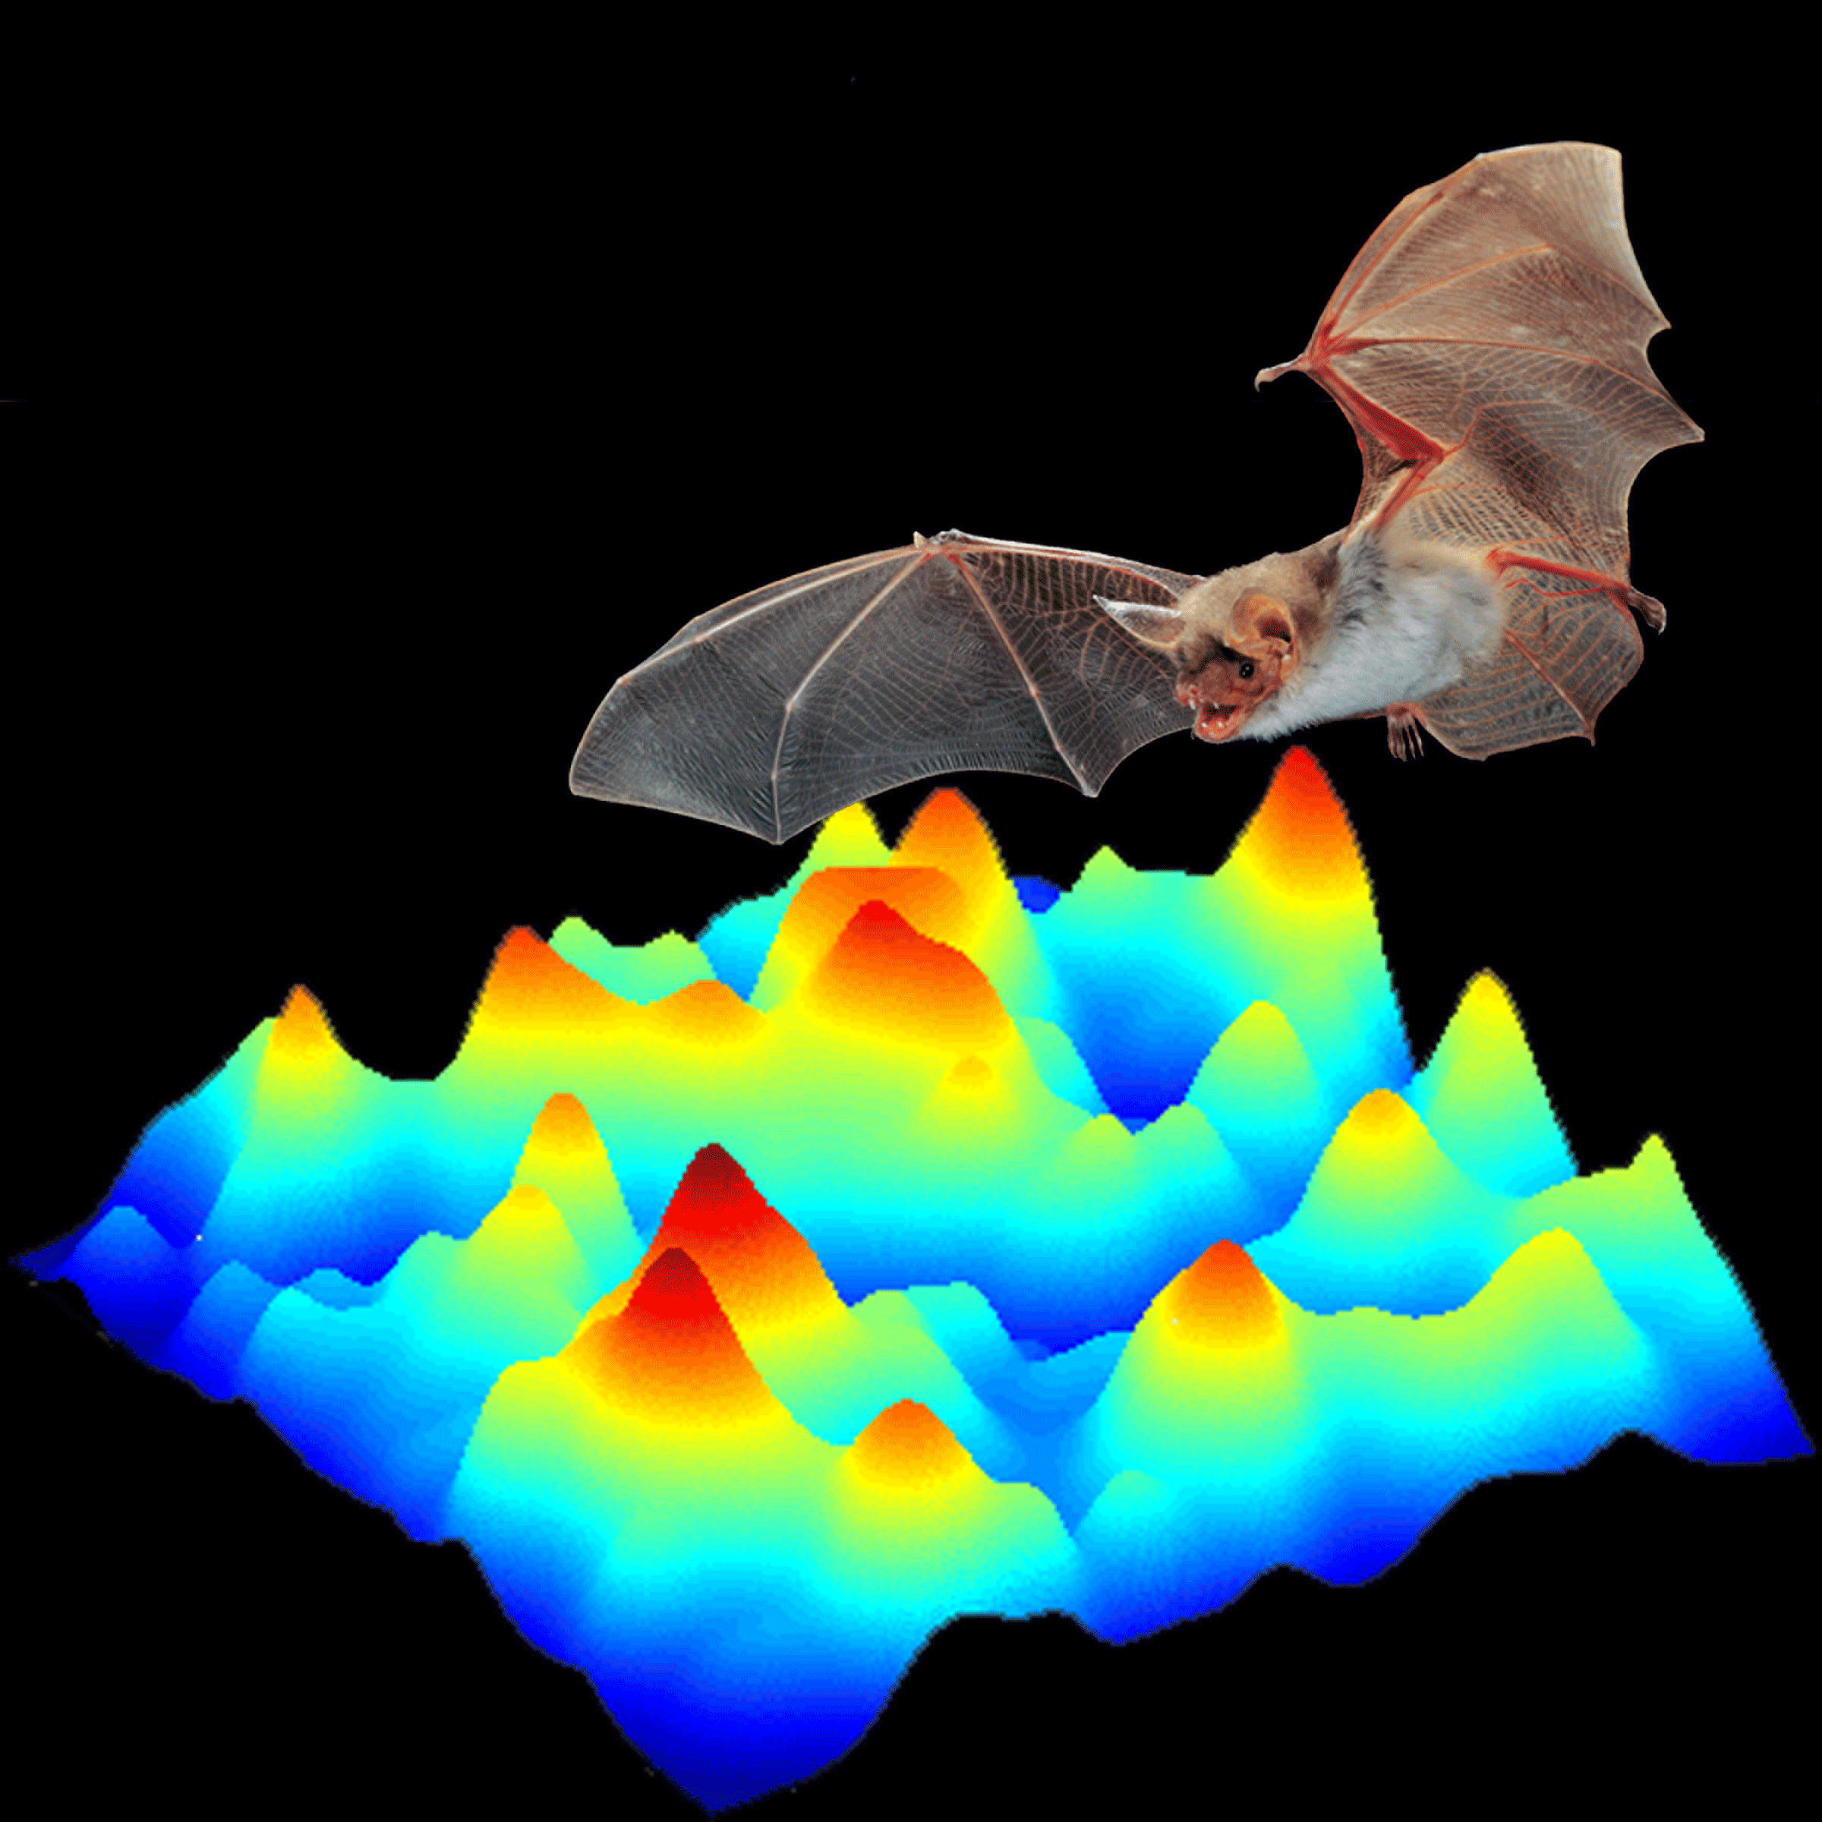
Challenge #4: Preparing to land: The engineers have estimated a range of landing spots…how does the module read the ground contours to know how far the capsule is above the surface?
Use radar, similar to how a bat flies.
Use a regular camera.

Slide 15
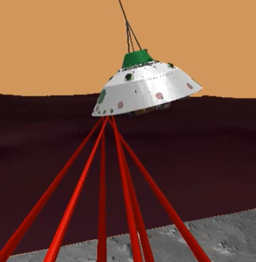
Correct!!!
With radar we can detect the distance to the ground just as bats do. Radar gives instantaneous feedback for decision making.
Back to Challenge #4 Home Go to Challenge #5

Slide 16
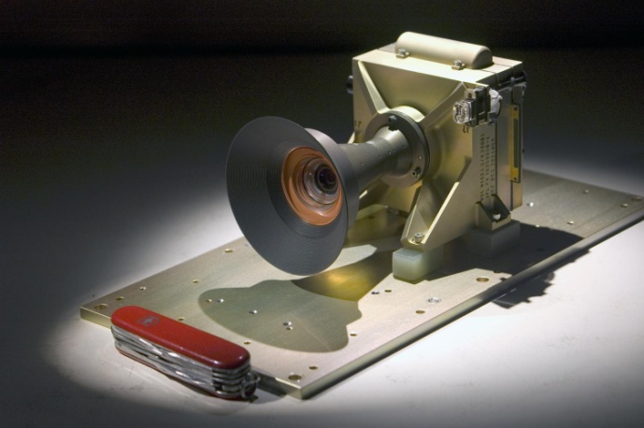
The images from a camera would take too long to process the information and make decisions; . (This is the actual cameral used on an earlier trip to Mars)
Back to Challenge #4 Home Go to Challenge #5

Slide 17
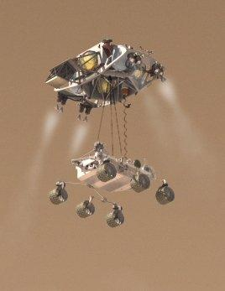
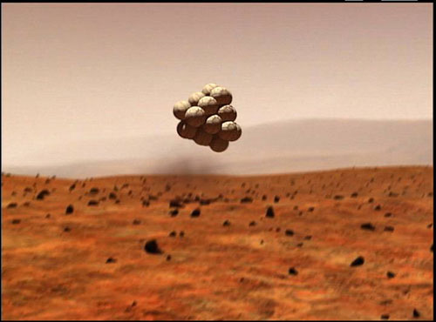
Challenge #5: How will you get the rover from the capsule to the surface? Which method would you choose?
Release the rover from the capsule in a protective casing of airbags and let it bounce until it stops.
Have the capsule slowly lower the rover to the ground using a “sky crane”.

Slide 18
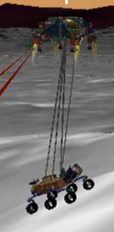
Correct!!!
The capsule has slowed down enough and has just enough fuel to hover over the ground to lower the rover with wheels out ready to roll! The capsule then cuts the cables and shoots away.
Click here to watch a drop test of the rover!
Back to Challenge #5 Home

Slide 19
The other rovers that have landed on mars used this method. It is less predictable and not as safe for the larger rover Curiosity that will be taking off in November 2011. The air bags will rip!
Back to Challenge #5 Home

Slide 20
Click here for a Video of an Engineer showing the different “parts” of the Mars Science Laboratory (rover “Curiosity”) while still in the lab!
Click Here for a Video Simulation of flight and landing of Curiosity on Mars
All done?…click here.

Slide 21
Click Here for a video review of “Newton’s Laws of Motion”
Click Here for a video review of
“Conservation of Energy:
Kinetic Energy = Potential Energy”
Done with the review?
Click here to go on to the “What does it take to land on Mars?” Activity.

Slide 22
In this activity your team gets a chance to see how well you did identifying the challenges of landing on Mars!
Compare the challenges you identified with the 5 challenges identified by NASA.
Each challenge gives your team the chance to see what you would do compared to NASA solutions. Click on all the links, but keep track of how many green “Correct!” slides you get on your first try.
When you are all done going through the challenges, go back to the “home” page and click on the video and simulation link to see the “Parts” tour here on Earth and a simulation what the mission could look like!
Get Started!

